Slide 1
Universal Turing Machine
Muhammad Amjad Iqbal

Slide 2
TM instructions in table format
We can built transition tables for Turing Machine as for FA/NFA.
From | To | Read | Write | Move
1 | 4 | a | a | L
3 | 1 | a | b | R
8 | 2 | b | a | R

Slide 3
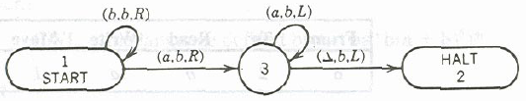
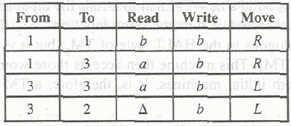
Example
can be represented as

Slide 4

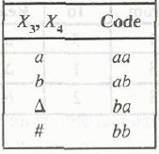
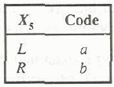
TM Encoding
We can code each and every row of the transition table by certain coding scheme
Consider the following general row

Slide 5
TM Encoding Contd.
For state number we can replace the state number by the as many number of a’s as the state number is
e.g. State 2 is encoded as aa
State 3 is encoded as aaa and so on

Slide 6

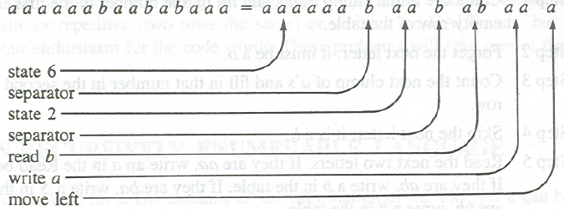
is encoded as follows

Slide 7
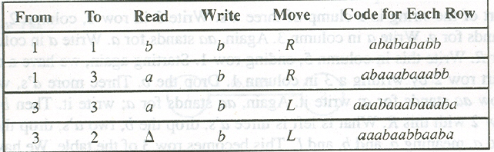
And the whole TM in above transition table can be written in single row as follows.
And is called CWL (Code Word Language)

Slide 8

Theorem 65
UTM exists
PROOF:
Initially encode the TM as follows
We are not responsible for any string not provided in the above form

Slide 9
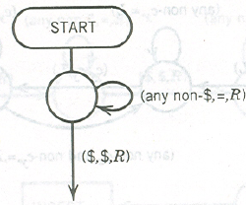
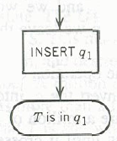
This marks the fact that T is in the state to the left of the UTM TAPE HEAD

Slide 10
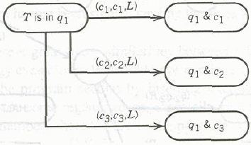
Read the next character
So we must search TMC for the combination
q_{x} & c_{y}

Slide 11
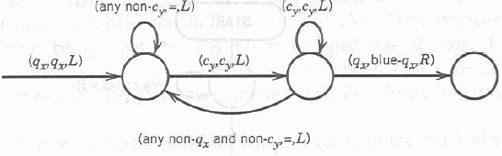
Search q_{x} & c_{y}
Searching q_{x} & c_{y} will be accomplished by following code.
Find the q_{x} and color it blue.
Now we know what should be next state.
If we can’t find the qx & cy combination and we reach #, then we should simulate crash.

Slide 12
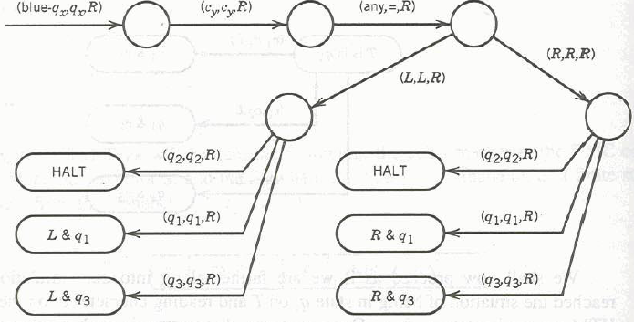
Now we know what should be written in place cy on data portion to the right of $.
Do it.
Run back to the TMC, find q_{x}-blue and mark it q_{x}.
Move the TAPE HEAD as specified and go to state as described by q_{x} & c_{y} combination.

Slide 13
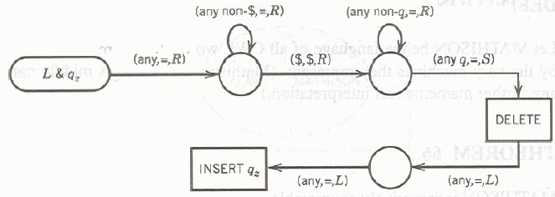
Now move to the right of $, where we marked qx.
delete it and insert new state q_{z}, either two cells before or after one cell we are in, depending upon the right or left move specified.
After inserting q_{z}, branch character c_{w} specified by new q_{z} & c_{w} combination

Slide 14
UTM termination
UTM will only terminates if TMC T instruction is to move to state q_{z} = q₂.
UTM have infinite tape, million of c’s, million of q’s, blue q’s, an L, an R, a #, a $.
But it does exactly we want to do.

Slide 15
Computable Function
If TM takes a sequence of numbers as input and leaves only one number as output, we say that the computer has acted like a mathematical function. Any operation that is defined on all sequence of K numbers ( for some K ≥1) and that can be performed by a TM is called Turing Computable or just computable.
Example addition, subtraction, max, min, multiplication are computable function and defined for K = 2.
Identity, successor are computable functions defined for K = 1, so there is only one input

Slide 16
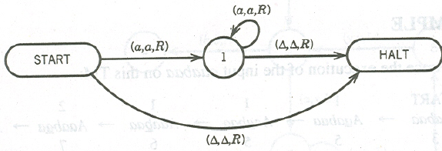
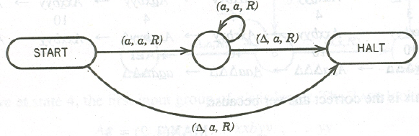
Identity TM
Successor TM

Slide 17
Alonzo Church’s Thesis (1936)
“It is believed that there is no functions that can be
defined by humans, whose calculation can be
described by any well-defined mathematical
algorithm that people can be taught to perform,
that cannot be computed by TM”
Unfortunately the Church thesis is not a theorem because the terms ( in red) are not part of any math branch and mathematical axioms deals with “people”.

Slide 18
Church’s thesis
Kurt Gödel
1930
Anything that can be defined by algorithm, can also be performed by TM/PM
David Hilbert in 1900 said following things to be proved by later mathematician
  Mathematics is consistent. Roughly we cant prove both a statement and its opposite to be true. Nor we can prove horrible like 1 = 2.
  Mathematics is complete. Roughly every “true” mathematical assertion can be proven. Every mathematical assertion can either be proven or disproven
  Mathematics is decidable. For every type of mathematical problem there is an algorithm that, “in theory” at least, can be mechanically followed to give a solution.
Church, Turing, Post
1936

Slide 19

End of Course

